Slide 1
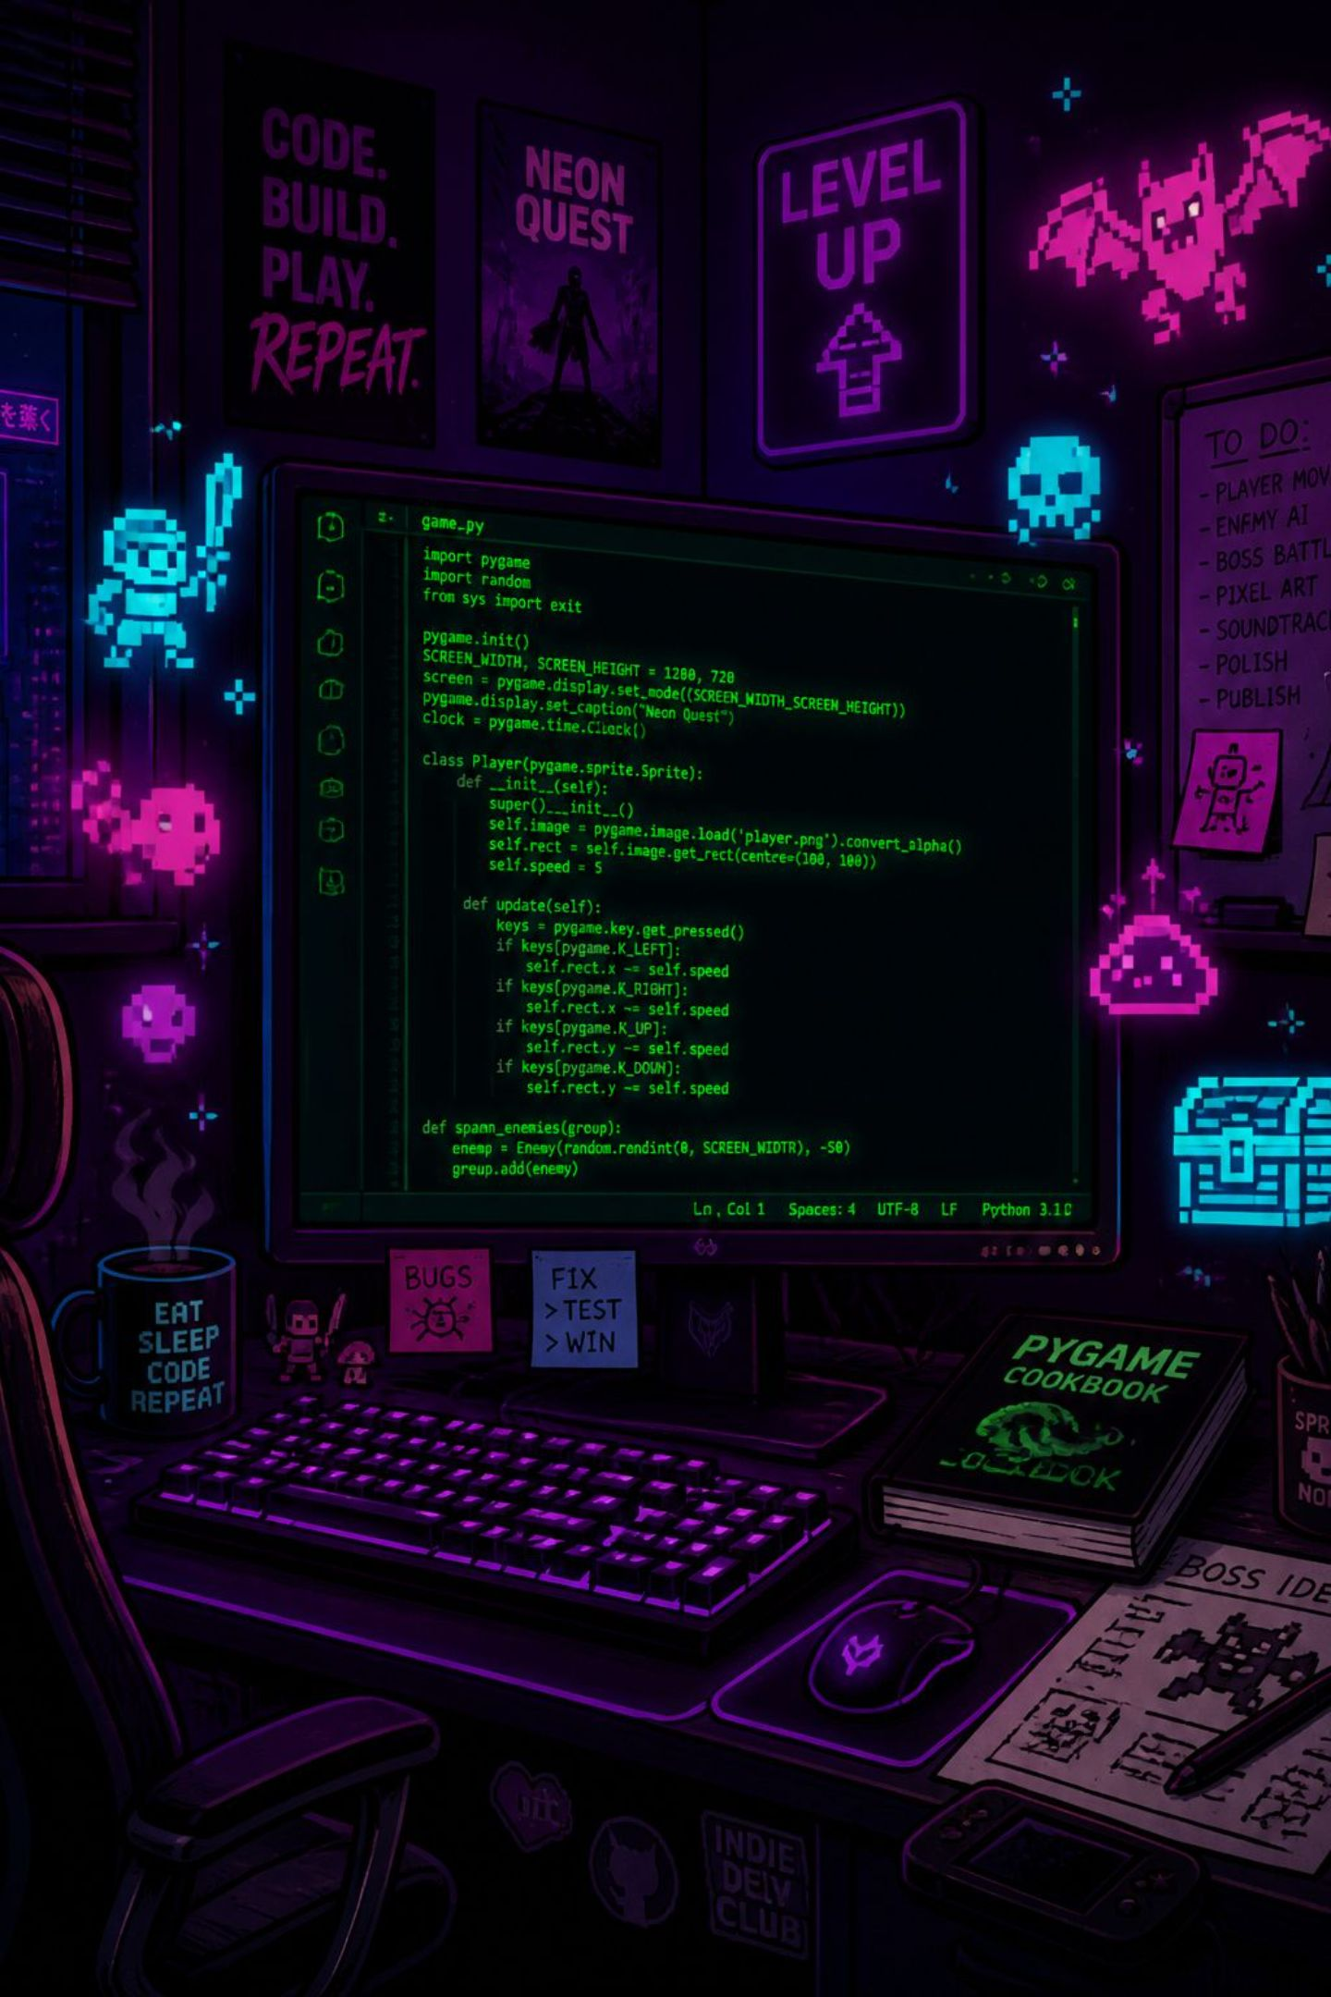
MY SHOOTER GAME
Interactive 2D Game Development with Pygame & Object-Oriented Programming
Supervised by Eng. Doaa Mohamed Taha

Slide 2



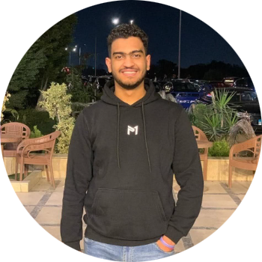
Meet the Team
Four developers. One modular codebase. Each member owned a distinct layer of the game — from the core engine loop to visual polish and audio integration.
Amr Khaled
Shahanda
Malak Hassouna
Ahmed Bassam
Game Leader — Core Engine, Game States, Main Loop & Timer
Entities Developer — Player Class, Target System & Health Logic
Physics & VFX — Collision Detection, Particle System & Screen Shake
UI & Audio — Interface Rendering, Sound Mixer & Asset Management

Slide 3
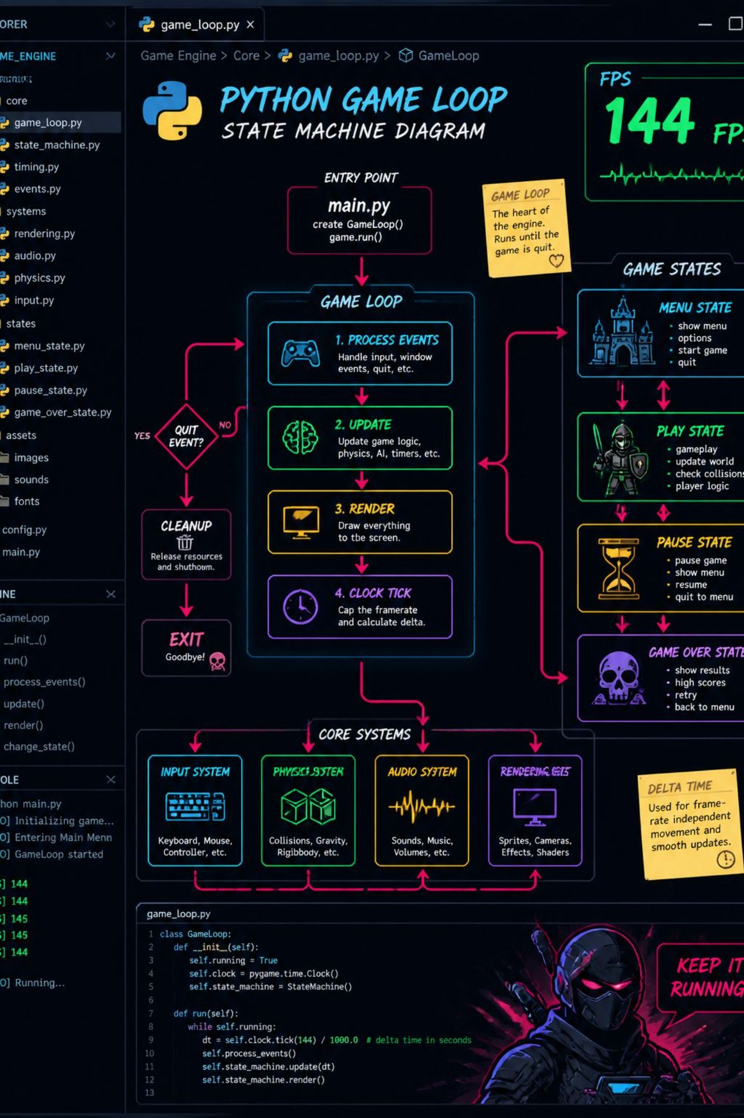
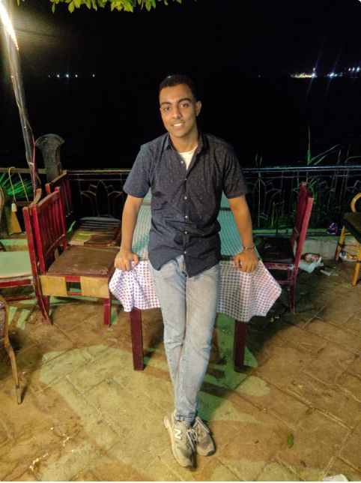




Amr Khaled
Game Leader
Main Loop & FPS
Built the core loop in main.py with stable FPS control and event handling.
Game State Manager
Designed the flow: Start Menu → Gameplay → Game Over for smooth transitions.
Round Timer
Programmed a 60-second countdown to drive pacing and end-game logic.
Module Integration
Unified all team modules into a clean execution flow with zero circular dependencies.

Slide 4
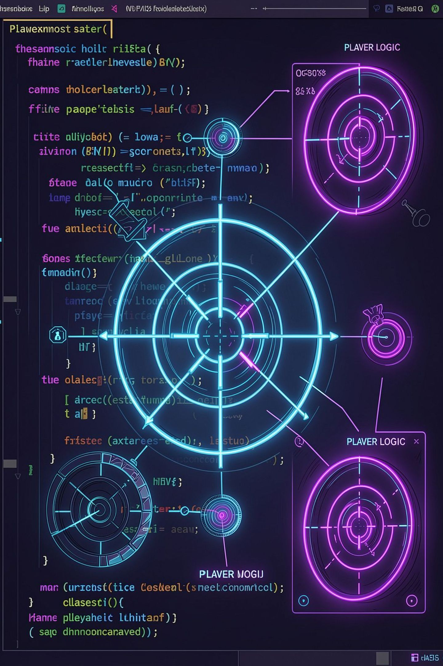




Shahanda
Entities Developer
Player & Crosshair Class
Implemented mouse-tracking crosshair with real-time shooting mechanics and projectile spawning logic.
Target System
Designed a Target class with randomized spawn positions, movement patterns, and progressive difficulty scaling across rounds.
Health & Lives
Built a robust lives management system — tracking player health, triggering game-over states, and resetting between rounds.

Slide 5
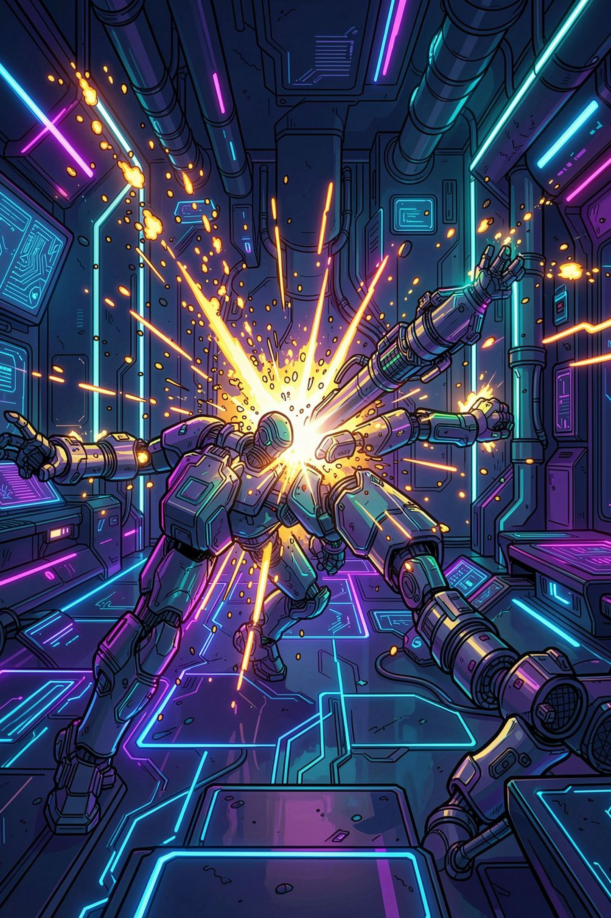




Malak Hassouna
Physics & VFX
Collision Detection
Developed precise pixel and bounding-box collision logic between bullets and targets — accurate, performant, and frame-consistent.
Particle System
Created a custom Particle class generating hit-explosion effects — each particle with velocity, fade-out, and lifetime management.
Screen Shake
Added dynamic screen-shake on impacts and explosions, delivering tactile feedback that elevates the overall gameplay experience.

Slide 6
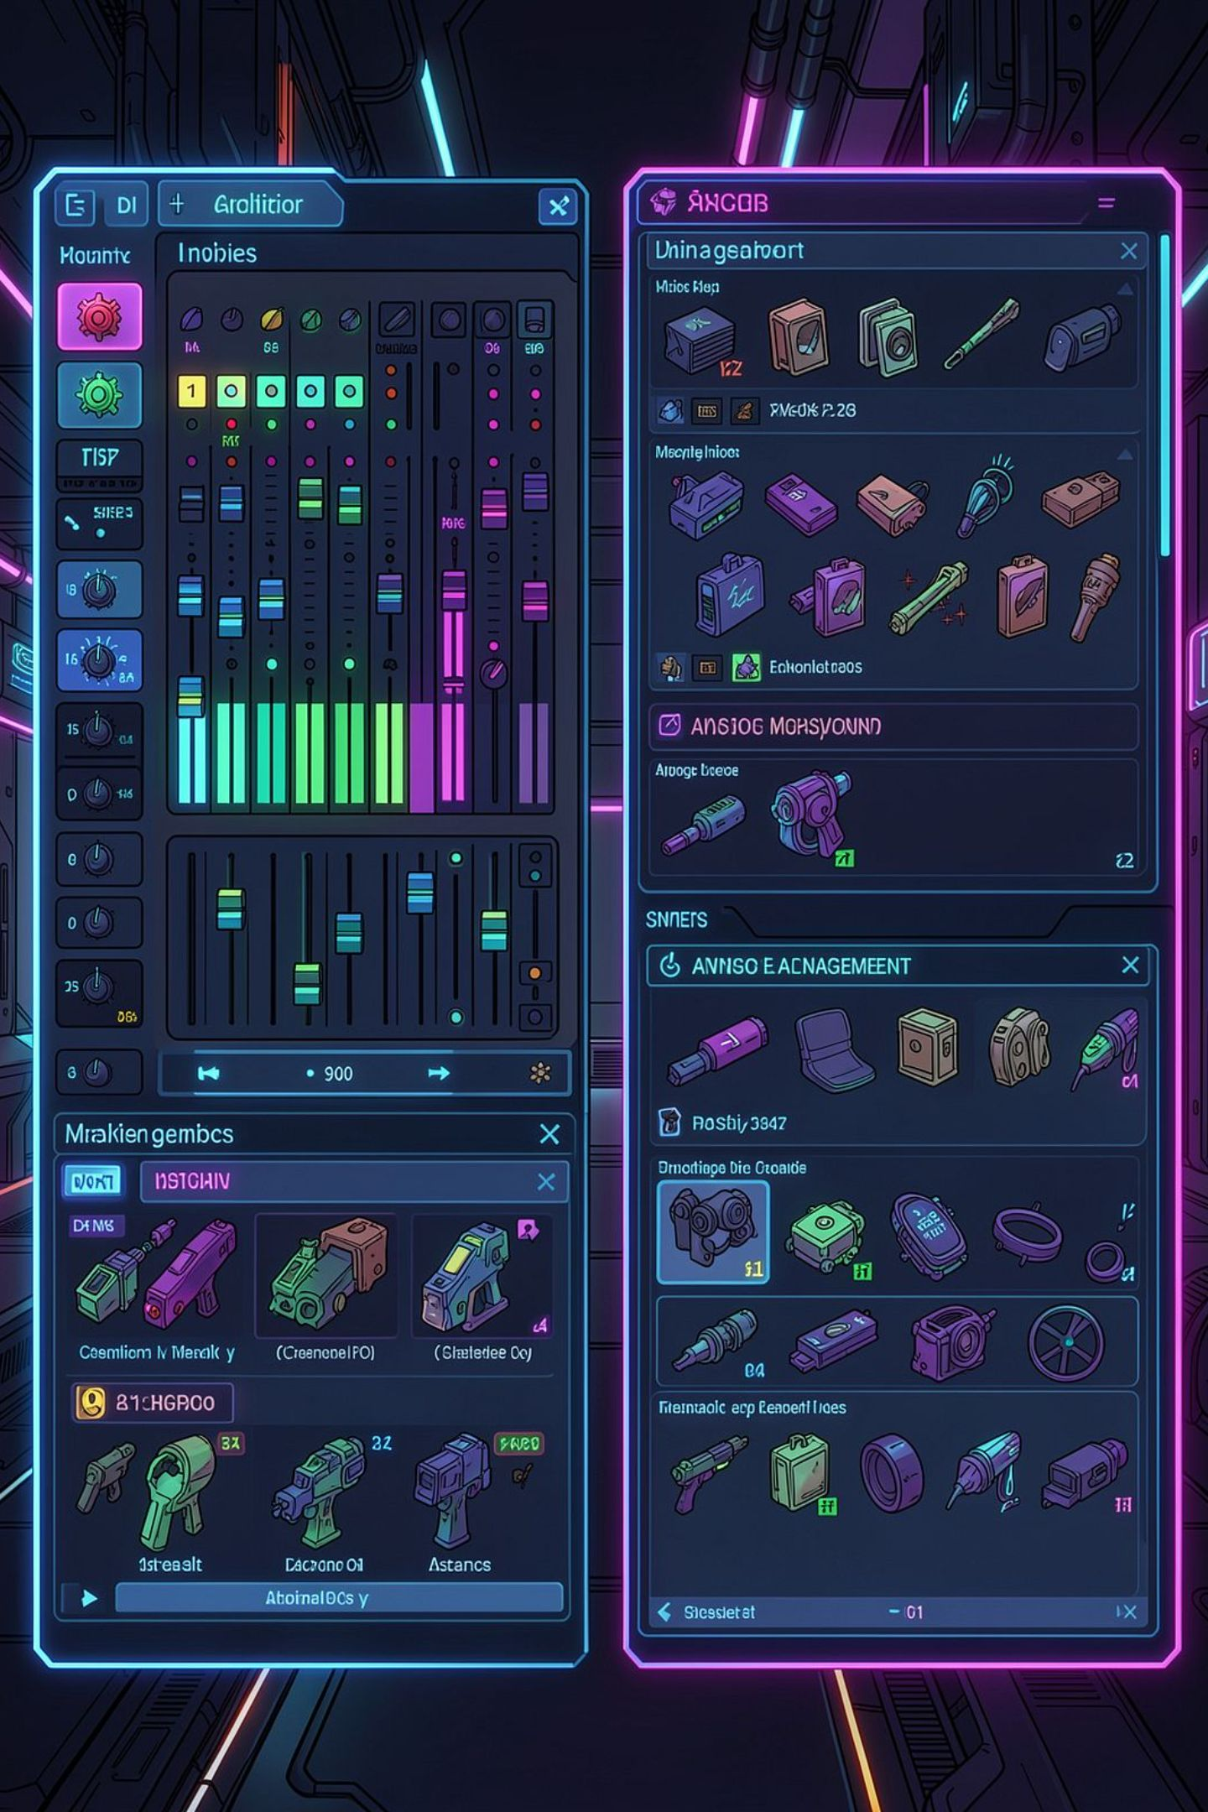
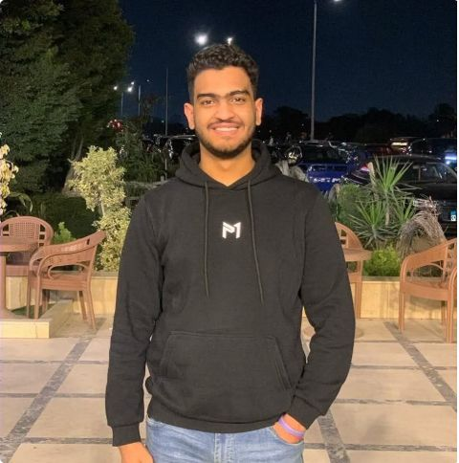




Ahmed Bassam
UI & Audio
UI Rendering
Built ui.py to display real-time Score and persistent High Score overlays during gameplay.
Audio Integration
Integrated pygame.mixer for background music, gunfire SFX, and explosion sounds with volume control.
Asset Pipeline
Organized the assets/ directory — sprites, fonts, and audio files — with consistent naming conventions.
High Score Persistence
Implemented file I/O to read/write highscore.txt, preserving player records across sessions.

Slide 7

Modular Architecture & Workflow
Project Directory Structure
Collaboration Strategy
The team adopted a modular OOP architecture — each developer worked on isolated modules, then merged via GitHub pull requests. Clear separation of concerns kept integration conflicts minimal and code reviews focused.
my_shooter_game/
├── main.py # Entry point, game loop
├── player.py # Player & Target classes
├── effects.py # Particles & screen shake
├── ui.py # Score UI & HUD
├── assets/
│ ├── sprites/
│ ├── fonts/
│ └── audio/
└── highscore.txt # Persistent data
Each .py file maps directly to a team member's domain, making the codebase easy to navigate and extend.

Slide 8
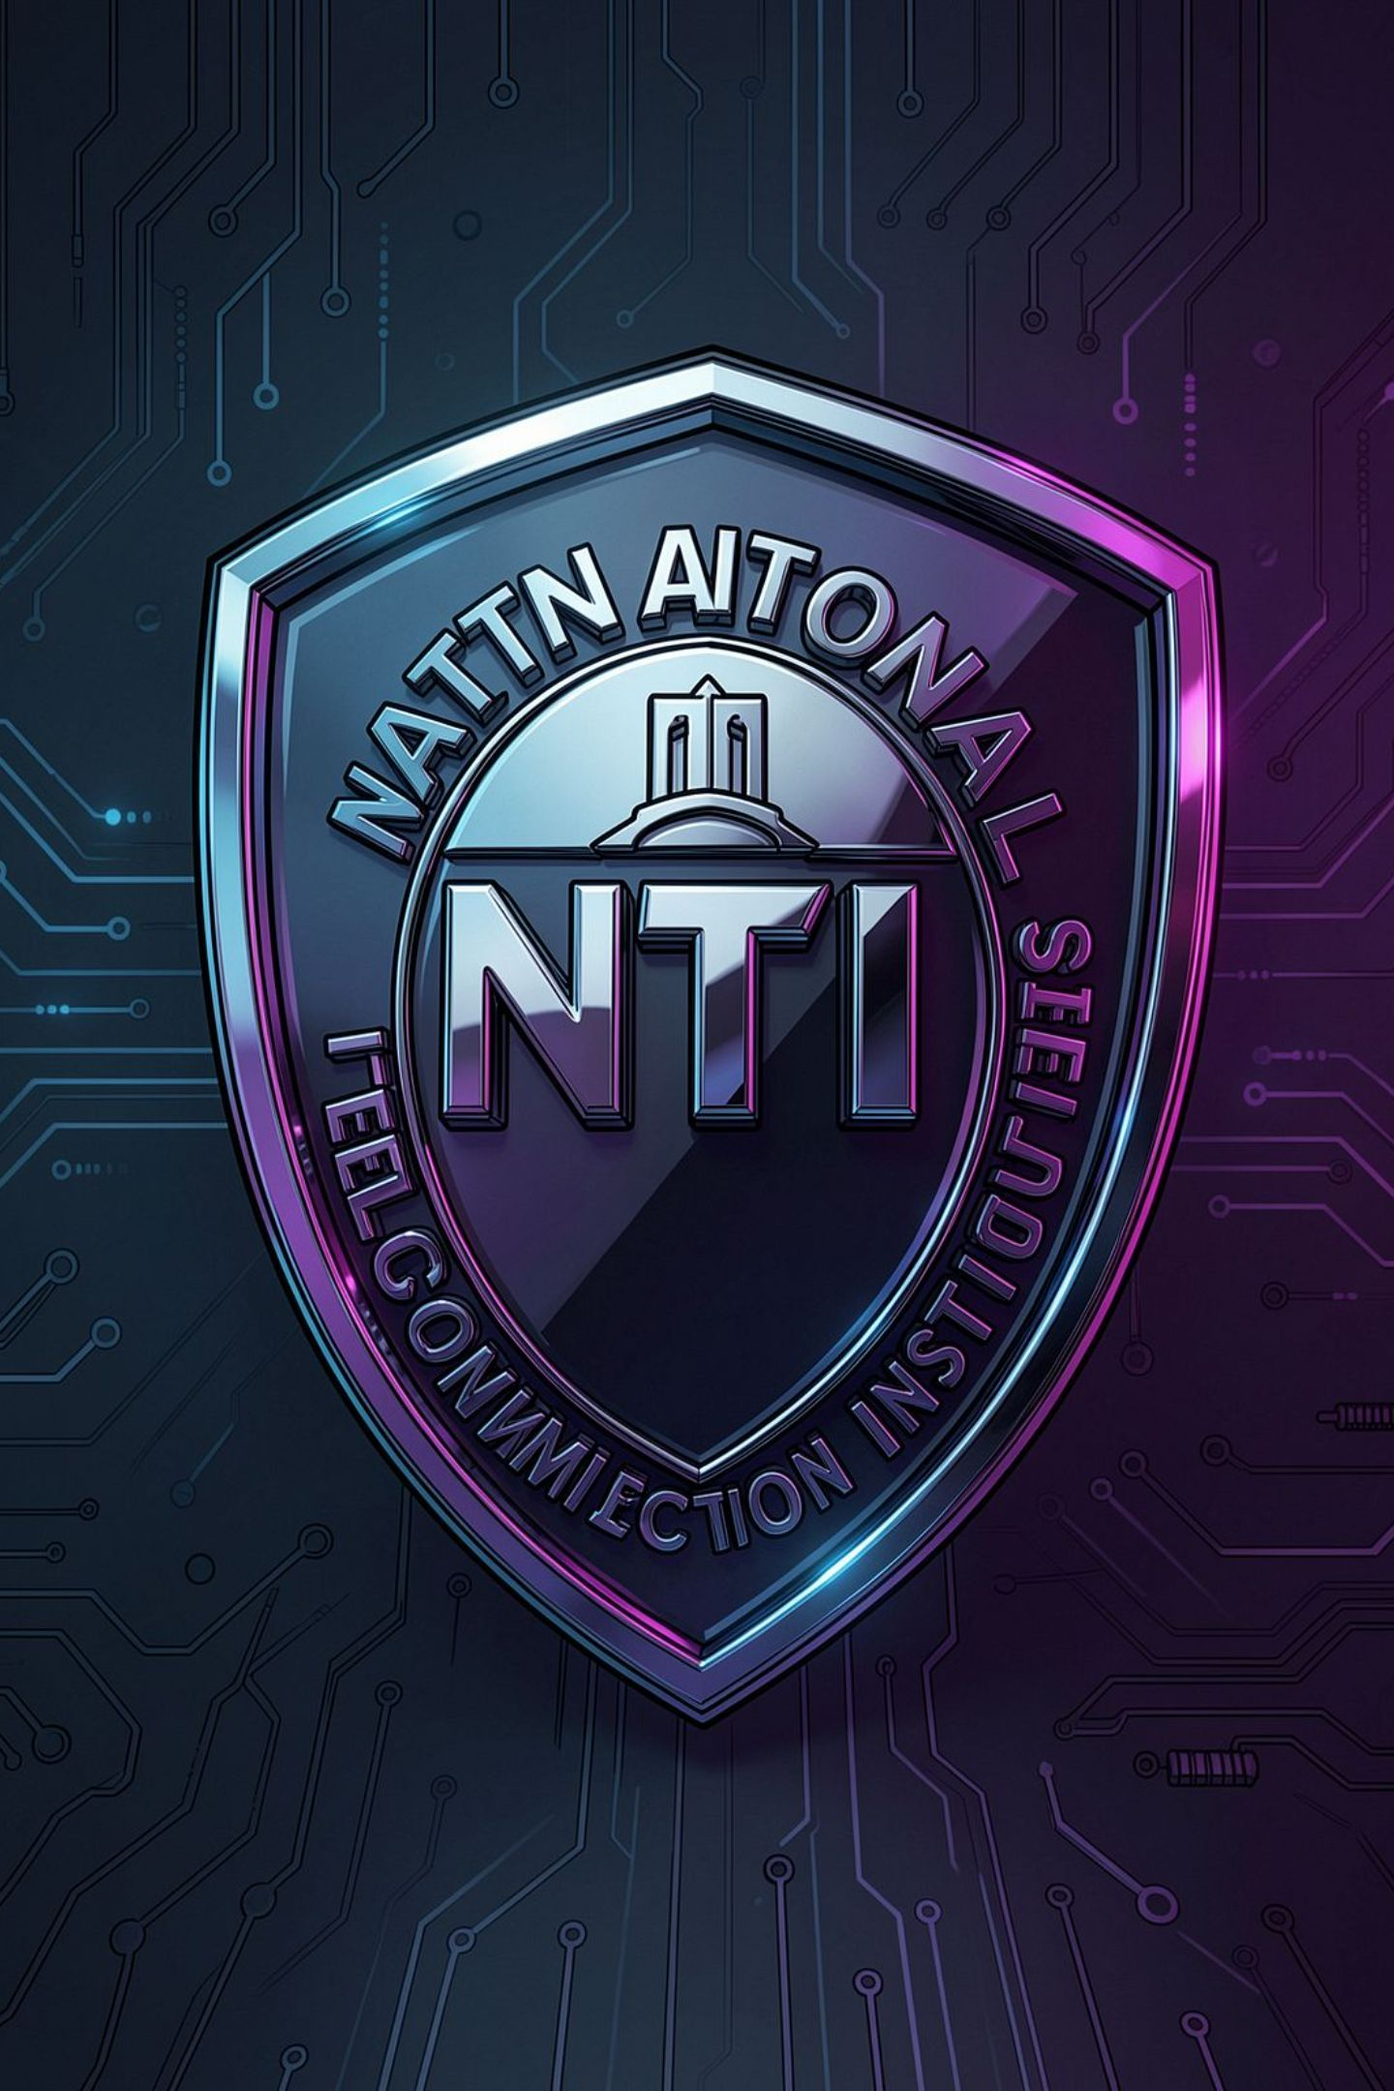
Conclusion & Acknowledgments
This project represents the culmination of hands-on Python training — applying OOP, game architecture, and collaborative development in a real-world context.
🎓 NTI Institute
Heartfelt thanks to the National Telecommunication Institute for the internship opportunity, resources, and structured Python curriculum.
🙏 Eng. Doaa Mohamed Taha
Special appreciation to our supervisor for her continuous guidance, technical mentorship, and unwavering support throughout the program.

